Slide 1
For Live Session Assignment (FLS)
Unit 5

Slide 2
Question 1: Quick Quiz Questions

Slide 3
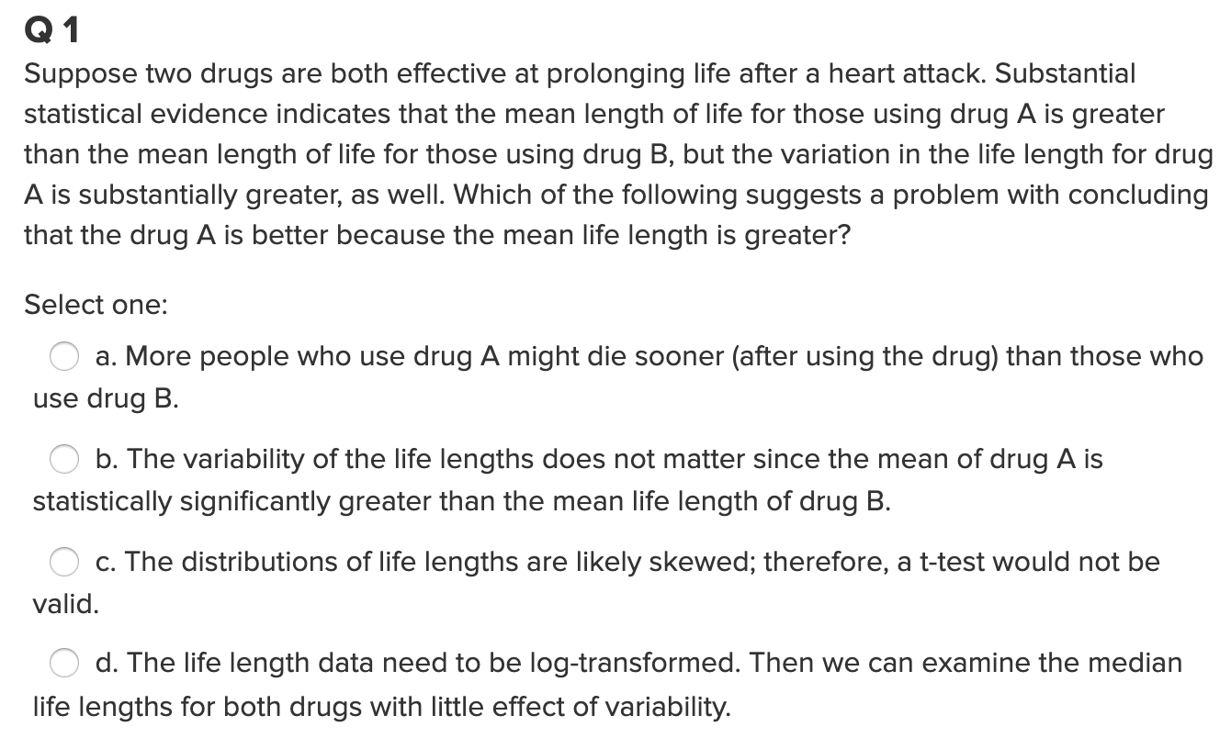
Question 1

Slide 4
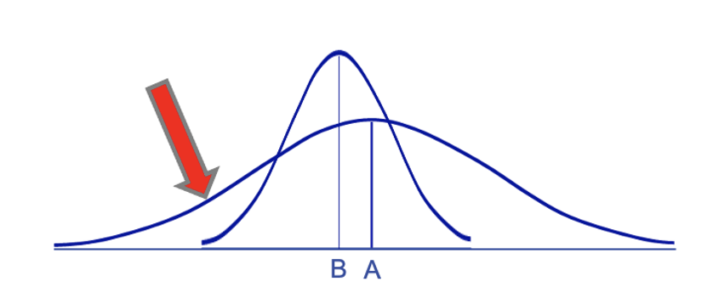
Question 1
3 years
While true, this does not “suggest a problem, as the question asked. ”

Slide 5
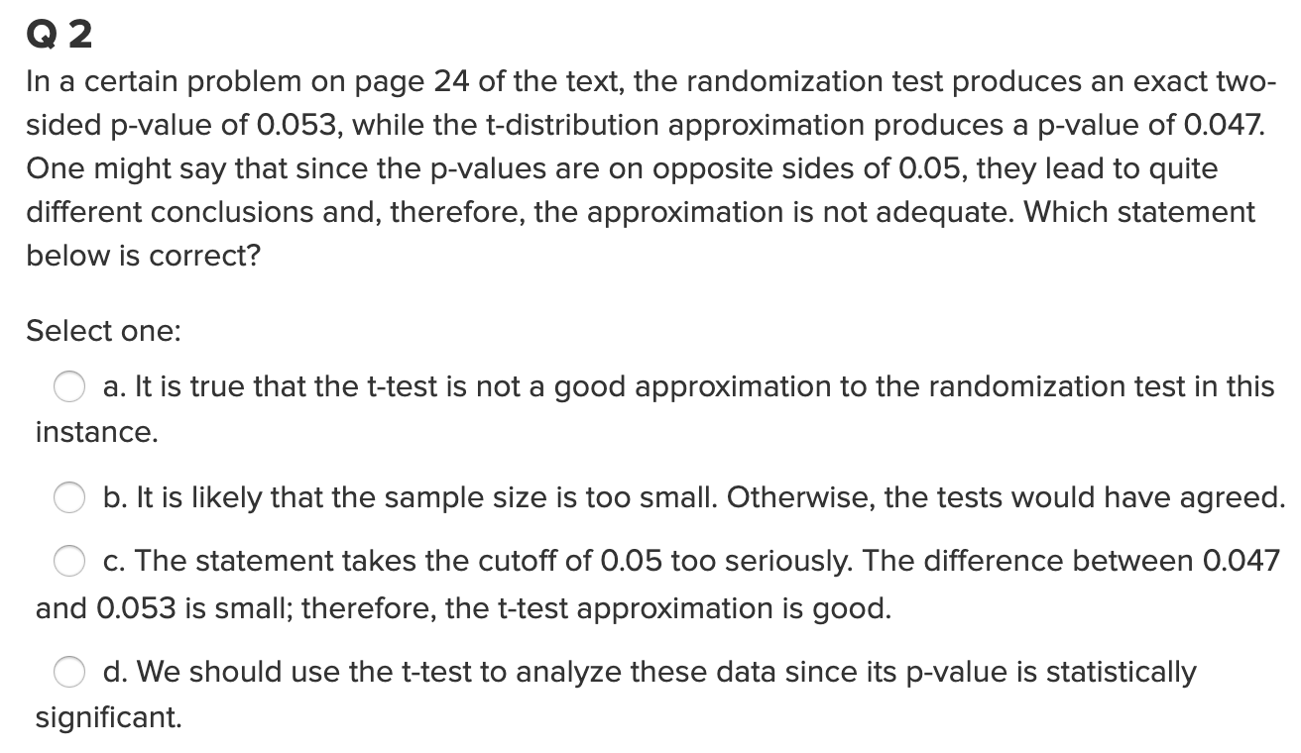
Question 2

Slide 6
Question 2

Slide 7
End Question 1

Slide 8

Question 2 ($≤2$ hours)

Slide 9
Ecology: Wildfires!
When wildfires ravage forests, the timber industry argues that logging (actual logging of trees … not the mathematical log!) the burned trees enhances forest recovery; the EPA argues the opposite. The 2002 Biscuit Fire in southwest Oregon provided a test case. Researchers selected 16 fire-affected plots in 2004, before any logging was done and counted tree seedlings along a randomly located transect pattern in each plot. They returned in 2005, after nine of the plots had been logged, and counted the tree seedlings along the same transects. The percent of seedlings lost from 2004 to 2005 is recorded in the file logging.csv for logged (L) and unlogged (U) plots:
Test the EPA’s assertion (and thus the opposite of the logging industries assertion) that logging (again…. not the mathematical log! :) actually increases the percentage of seedlings lost from 2004 to 2005.
Perform a complete analysis using a rank sum test in SAS. (Logging data).
Verify the p-value and confidence interval by running the rank sum test in R (using R function Wilcox.test). (You do not need to repeat the complete analysis … simply cut and paste a screen shot of your code and the output.) You may use: https://www.r-bloggers.com/wilcoxon-mann-whitney-rank-sum-test-or-test-u/ for reference.
Finally, perform a permutation test for the difference of means. Finally, perform a permutation test for the difference of means. As with all ”tests”, this should include a clear conclusion written in the context of the problem and in terms understandable by a client (although it should also include a pvalue.)

Slide 10
Ecology: Wildfires!
When wildfires ravage forests, the timber industry argues that logging (actual logging of trees … not the mathematical log!) the burned trees enhances forest recovery; the EPA argues the opposite. The 2002 Biscuit Fire in southwest Oregon provided a test case. Researchers selected 16 fire-affected plots in 2004, before any logging was done and counted tree seedlings along a randomly located transect pattern in each plot. They returned in 2005, after nine of the plots had been logged, and counted the tree seedlings along the same transects. The percent of seedlings lost from 2004 to 2005 is recorded in the file logging.csv for logged (L) and unlogged (U) plots:
Test the EPA’s assertion (and thus the opposite of the logging industries assertion) that logging (again…. not the mathematical log! :) actually increases the percentage of seedlings lost from 2004 to 2005.
Perform a complete analysis using a rank sum test in SAS. (Logging data).

Slide 11
State the Problem
Problem:
Test the EPA’s assertion (and thus the opposite of the logging industry’s assertion) that logging actually increases the percentage of seedlings lost from 2004 to 2005.

Slide 12
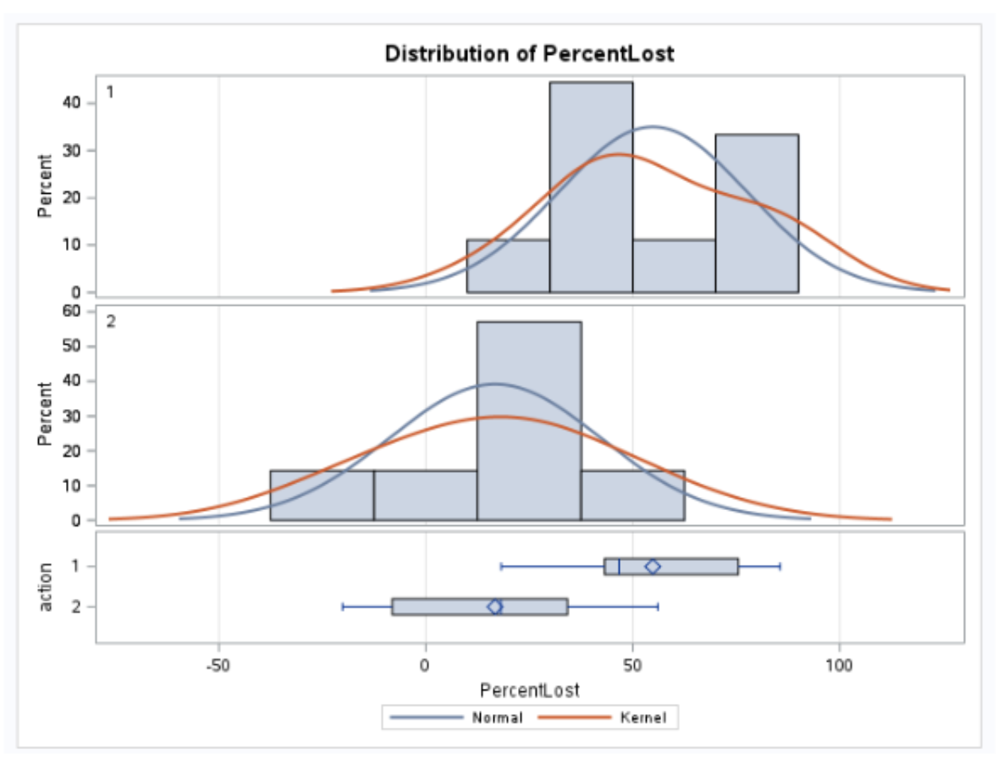
Assumptions of the Rank Sum Test
Assumptions:
The data are ordinal as they are percentages of seedlings.
We will assume the observations are independent, although significant spatial correlation may be present.
You may also have assumed that the distributions were the same, except for location.

Slide 13
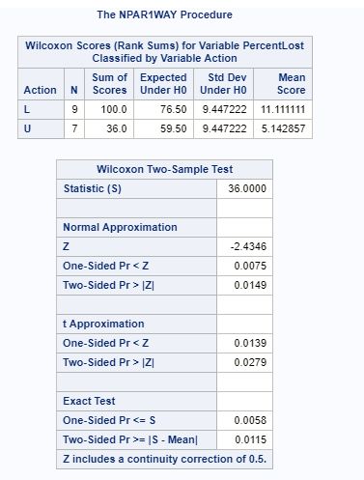
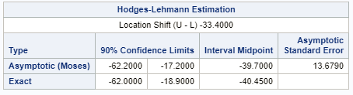
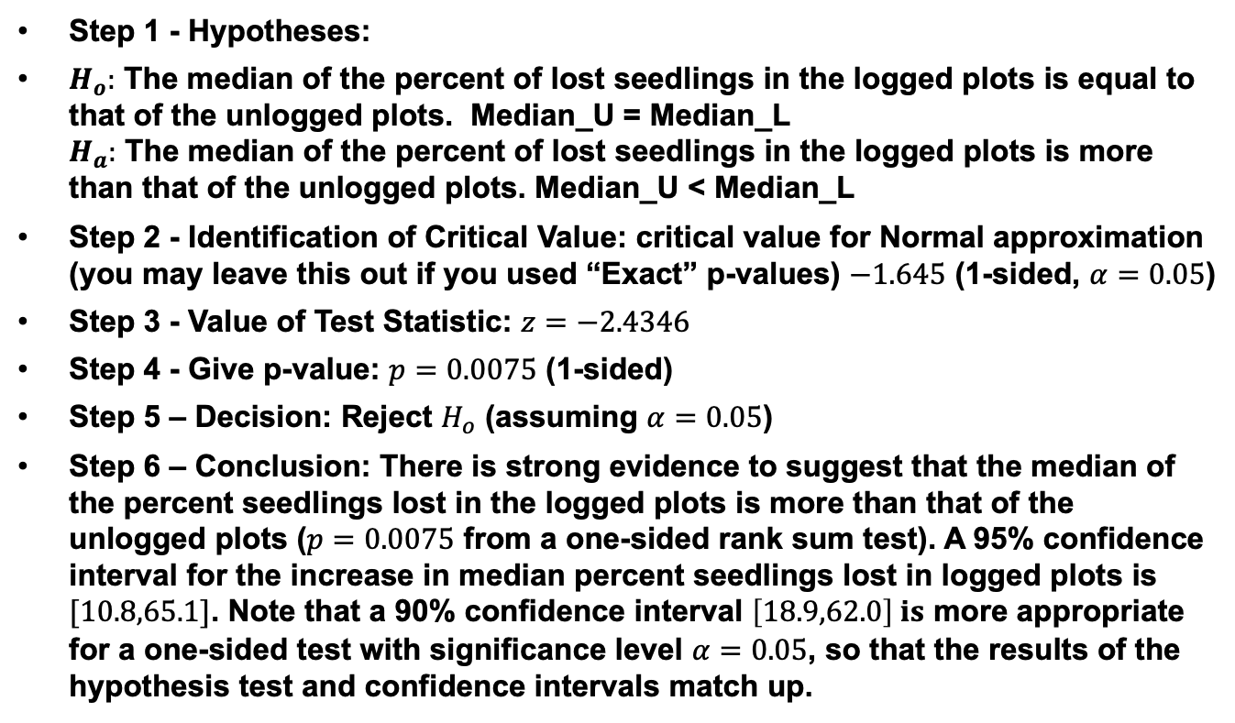
6 Step Rank Sum Test
Step 1 - Hypotheses:
$H_{o}:$ The median of the percent of lost seedlings in the logged plots is equal to that of the unlogged plots. Median_U = Median_L $H_{a}:$ The median of the percent of lost seedlings in the logged plots is more than that of the unlogged plots. Median_U < Median_L
Step 2 - Identification of Critical Value: critical value for Normal approximation (you may leave this out if you used “Exact” p-values) $−1.645$ (1-sided, $α=0.05$)
Step 3 - Value of Test Statistic: $z=−2.4346$
Step 4 - Give p-value: $p=0.0075$ (1-sided)
Step 5 – Decision: Reject $H_{o}$ (assuming $α=0.05$)
Step 6 – Conclusion: There is strong evidence to suggest that the median of the percent seedlings lost in the logged plots is more than that of the unlogged plots ($p=0.0075$ from a one-sided rank sum test). A 95% confidence interval for the increase in median percent seedlings lost in logged plots is $[10.8,65.1]$. Note that a 90% confidence interval $\left[18.9,62.0\right] is$ more appropriate for a one-sided test with significance level $α=0.05$, so that the results of the hypothesis test and confidence intervals match up.
SAS:
*To compute rank sum test;
proc npar1way data = loggingdata wilcoxon;
class Action;
var PercentLost;
exact HL Wilcoxon;
run;
proc npar1way data = loggingdata wilcoxon alpha = 0.1;
class Action;
var PercentLost;
exact HL Wilcoxon;
run;
Proc npar1way reference: https://support.sas.com/documentation/onlinedoc/stat/142/npar1way.pdf page 6776

Slide 14
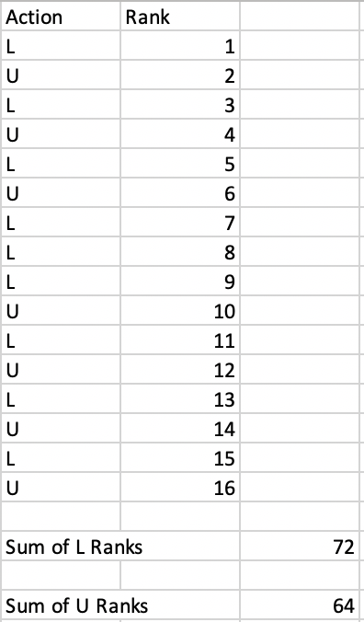


The Rank Sum Test: If Logging Had No Effect on % of Seedlings, Then these would not be surprising outcomes of the experiment.
U
L
64
72

Slide 15
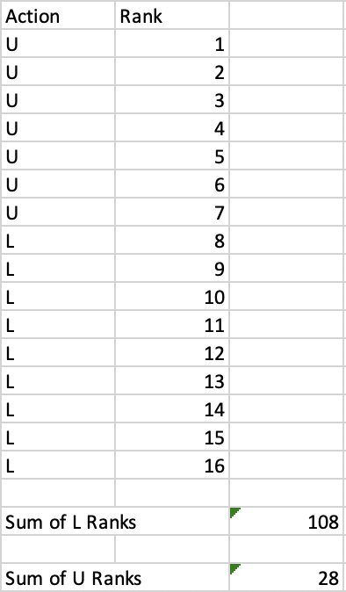
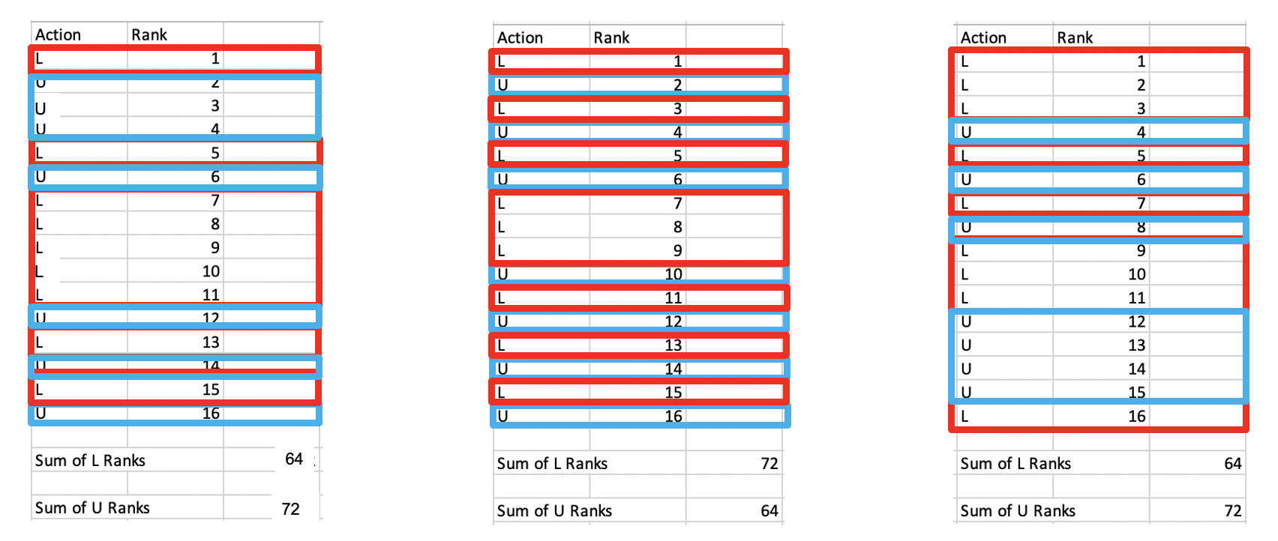
The Rank Sum Test: What would be the most evidence that L was Bigger?
If logging didn’t have any effect, it is possible that all the unlogged plots would randomly have the smallest percentage of lost seedlings … but it is not plausible … this is reflected in the Sum of the Ranks when compared to the others that come from random assignment of the labels ...

Slide 16
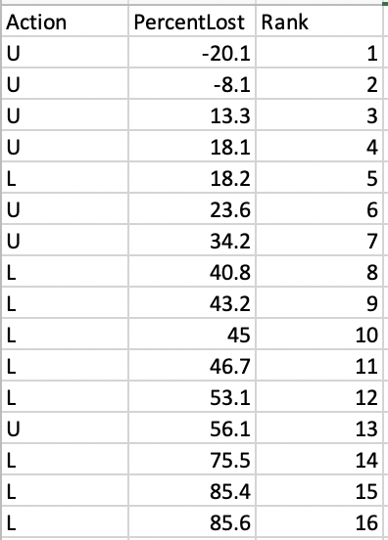
Rank Sum Test: Here is the Outcome of the Experiment that we ran!
Sum of the L ranks: 5+8+9+1-+11+12+14+15+16 = 100
Sum of the U ranks: 1+2+3+4+6+7+13 = 36

Slide 17
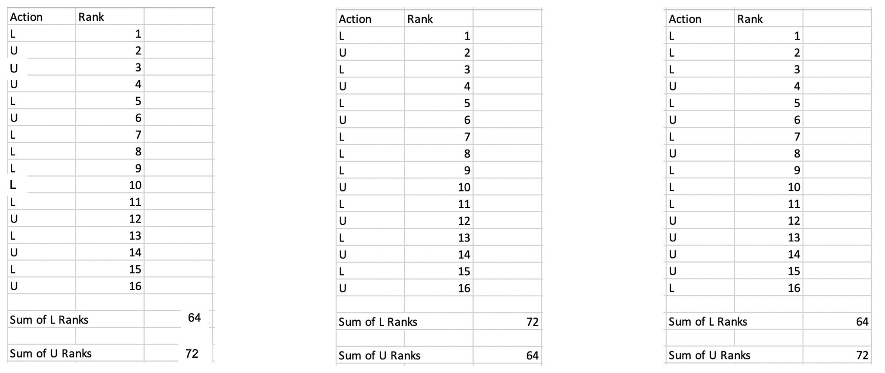
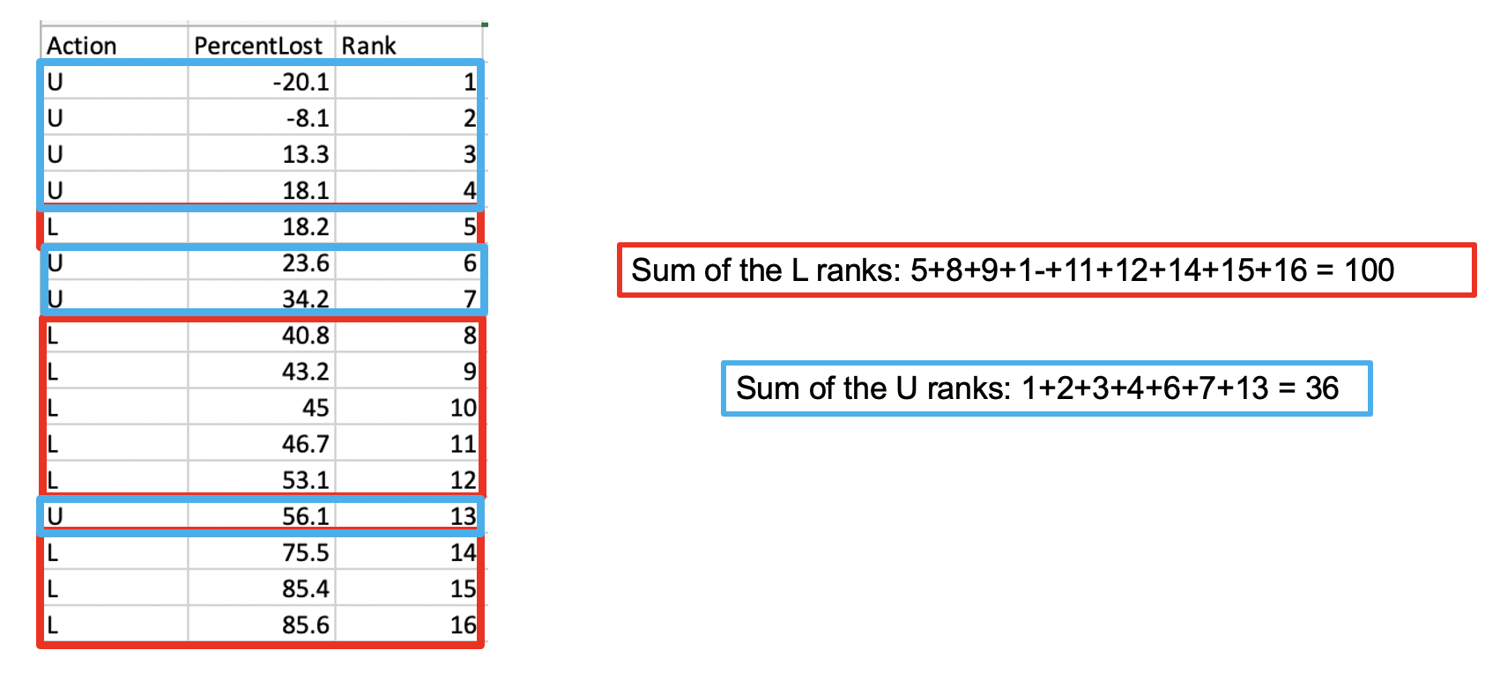
Rank Sum Test: Strategy
1. Assume the Medians are the same
2. Evidence
If the are then the above results would not be surprising.
3. Probability
What is the probability that the sum of the ranks of the UnLogged plots would be 36 or less if the distributions were the same and we could thus scramble the labels.
4. Decision / Conclusion
Let’s find out!

Slide 18
6 Step Rank Sum Test
Step 1 - Hypotheses:
$H_{o}:$ The median of the percent of lost seedlings in the logged plots is equal to that of the unlogged plots. Median_U = Median_L $H_{a}:$ The median of the percent of lost seedlings in the logged plots is more than that of the unlogged plots. Median_U < Median_L
Step 2 - Identification of Critical Value: critical value for Normal approximation (you may leave this out if you used “Exact” p-values) $−1.645$ (1-sided, $α=0.05$)
Step 3 - Value of Test Statistic: $z=−2.4346$
Step 4 - Give p-value: $p=0.0075$ (1-sided)
Step 5 – Decision: Reject $H_{o}$ (assuming $α=0.05$)
Step 6 – Conclusion: There is strong evidence to suggest that the median of the percent seedlings lost in the logged plots is more than that of the unlogged plots ($p=0.0075$ from a one-sided rank sum test). A 95% confidence interval for the increase in median percent seedlings lost in logged plots is $[10.8,65.1]$. Note that a 90% confidence interval $\left[18.9,62.0\right] is$ more appropriate for a one-sided test with significance level $α=0.05$, so that the results of the hypothesis test and confidence intervals match up.
SAS:
*To compute rank sum test;
proc npar1way data = loggingdata wilcoxon;
class Action;
var PercentLost;
exact HL Wilcoxon;
run;
proc npar1way data = loggingdata wilcoxon alpha = 0.1;
class Action;
var PercentLost;
exact HL Wilcoxon;
run;
Proc npar1way reference: https://support.sas.com/documentation/onlinedoc/stat/142/npar1way.pdf page 6776

Slide 19
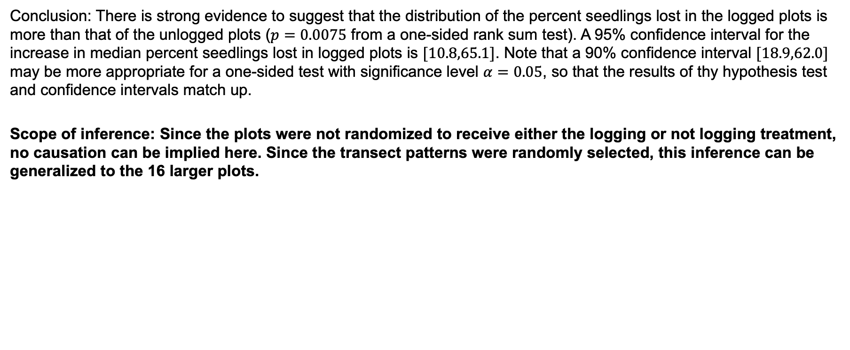
Scope of Inference
Conclusion: There is strong evidence to suggest that the distribution of the percent seedlings lost in the logged plots is more than that of the unlogged plots ($p=0.0075$ from a one-sided rank sum test). A 95% confidence interval for the increase in median percent seedlings lost in logged plots is $[10.8,65.1]$. Note that a 90% confidence interval $[18.9,62.0]$ may be more appropriate for a one-sided test with significance level $α=0.05$, so that the results of thy hypothesis test and confidence intervals match up.
Scope of inference: Since the plots were not randomized to receive either the logging or not logging treatment, no causation can be implied here. Since the transect patterns were randomly selected, this inference can be generalized to the 16 larger plots.

Slide 20
Ecology: Wildfires!
When wildfires ravage forests, the timber industry argues that logging (actual logging of trees … not the mathematical log!) the burned trees enhances forest recovery; the EPA argues the opposite. The 2002 Biscuit Fire in southwest Oregon provided a test case. Researchers selected 16 fire-affected plots in 2004, before any logging was done and counted tree seedlings along a randomly located transect pattern in each plot. They returned in 2005, after nine of the plots had been logged, and counted the tree seedlings along the same transects. The percent of seedlings lost from 2004 to 2005 is recorded in the file logging.csv for logged (L) and unlogged (U) plots:
Test the EPA’s assertion (and thus the opposite of the logging industries assertion) that logging (again…. not the mathematical log! :) actually increases the percentage of seedlings lost from 2004 to 2005.
Perform a complete analysis using a rank sum test in SAS. (Logging data).
Verify the p-value and confidence interval by running the rank sum test in R (using R function Wilcox.test). (You do not need to repeat the complete analysis … simply cut and paste a screen shot of your code and the output.) You may use: https://www.r-bloggers.com/wilcoxon-mann-whitney-rank-sum-test-or-test-u/ for reference.

Slide 21
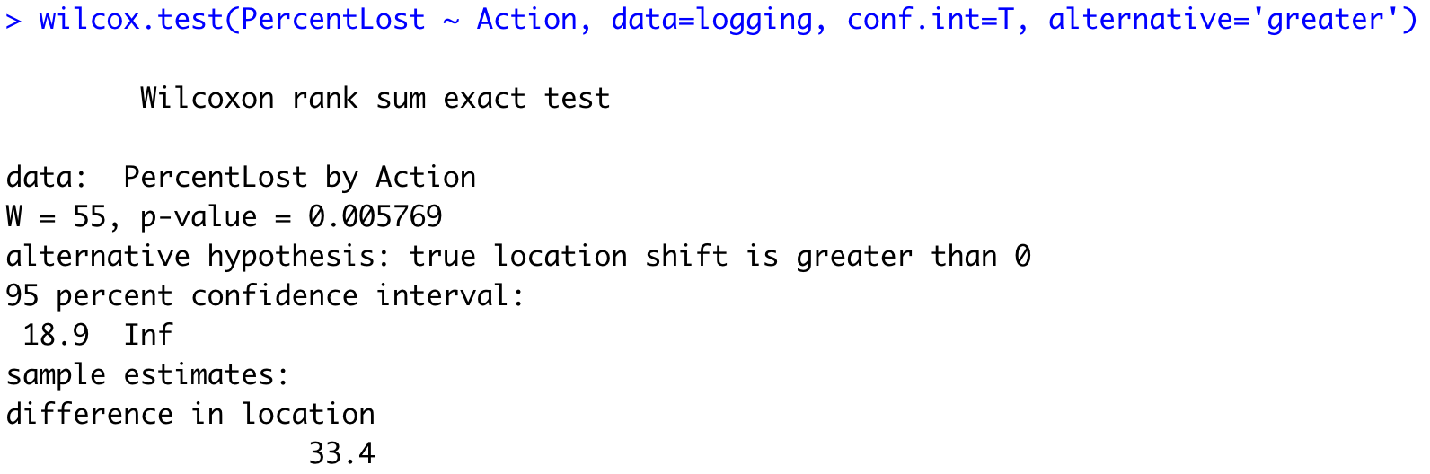
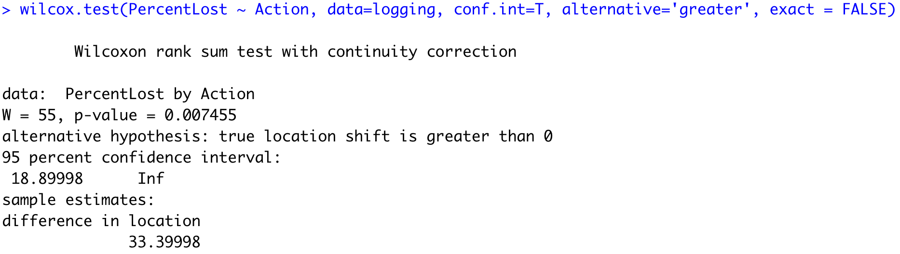
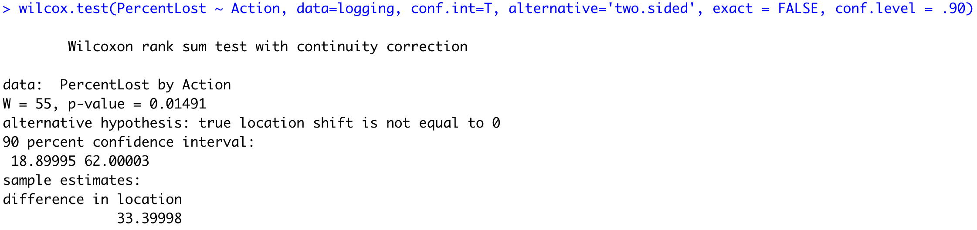


$W_{1}=n_{1}∗n_{2}+ \frac{n_{1}\left(n_{1}+1\right)}{2}$ $− Sum of Ranks_{1}$
Note: by default, R provides the exact p-value rather than the normal approximation for the p-value for smaller sample sizes.
$W_{2}=n_{1}∗n_{2}+ \frac{n_{2}\left(n_{2}+1\right)}{2}$ $− Sum of Ranks_{2}$
Note: The ‘conf.int’ and conf.level options provides the HL confidence limits which should match SAS exactly
The lower one is usually used.

Slide 22
$W_{1}=n_{1}∗n_{2}+ \frac{n_{1}\left(n_{1}+1\right)}{2}$ $− Sum of Ranks_{1}$
Note: by default, R provides the exact p-value rather than the normal approximation for the p-value for smaller sample sizes.
Note: The ‘conf.int’ and conf.level options provides the HL confidence limits which should match SAS exactly

Slide 23
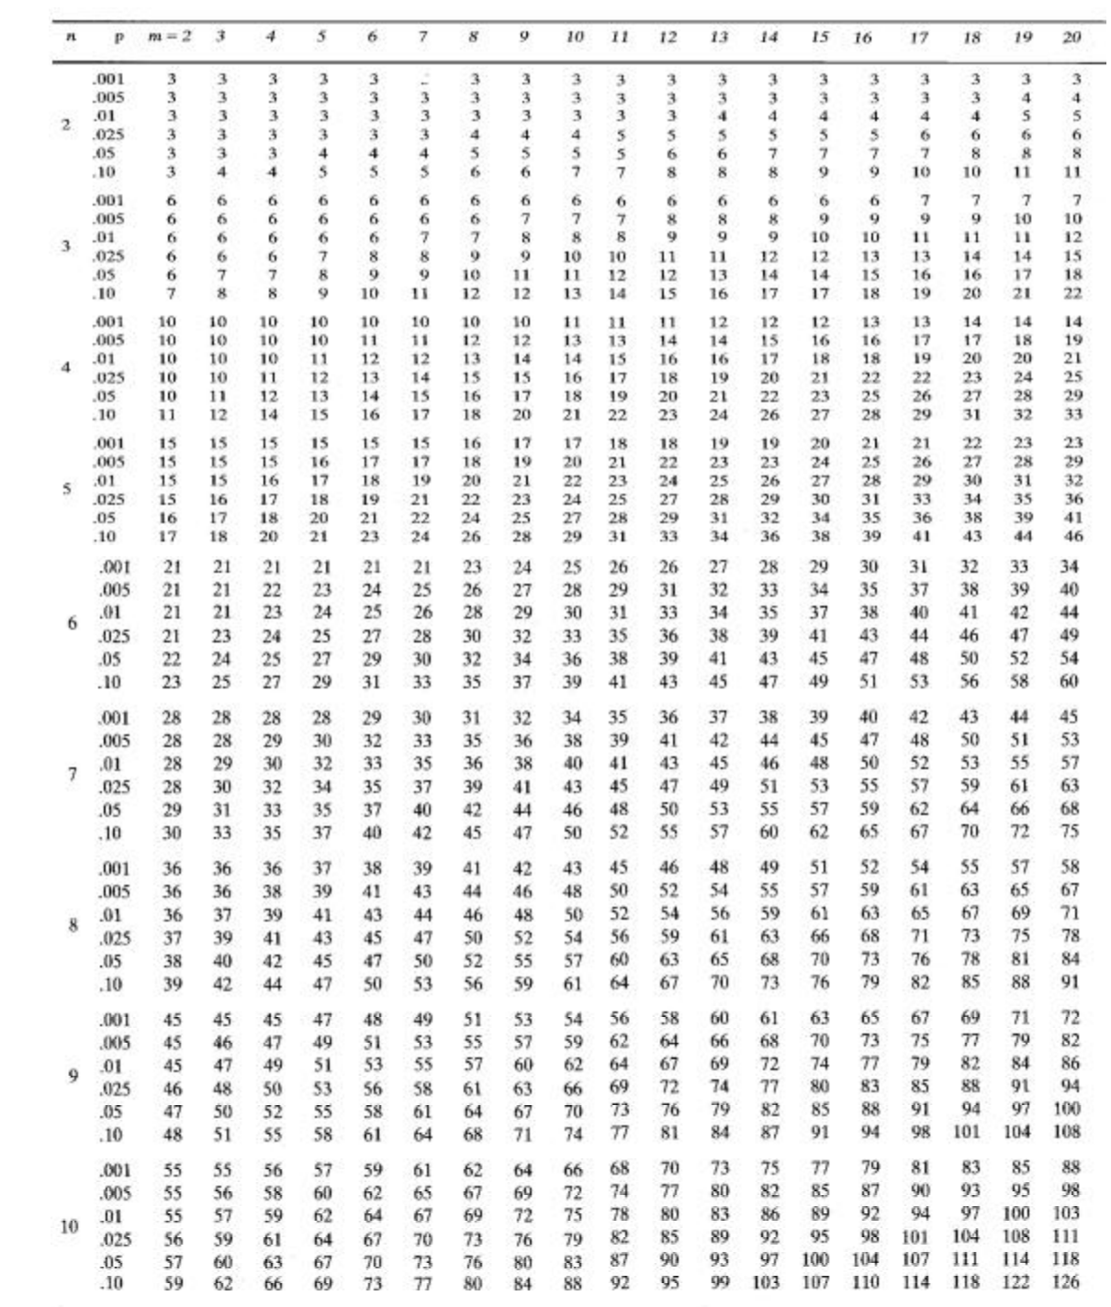
W = 55
Pvalue ~ .01
https://onlinepubs.trb.org/onlinepubs/nchrp/cd-22/manual/v2appendixc.pdf
https://sphweb.bumc.bu.edu/otlt/mph-modules/bs/bs704_nonparametric/bs704_nonparametric4.html

Slide 24
Ecology: Wildfires!
When wildfires ravage forests, the timber industry argues that logging (actual logging of trees … not the mathematical log!) the burned trees enhances forest recovery; the EPA argues the opposite. The 2002 Biscuit Fire in southwest Oregon provided a test case. Researchers selected 16 fire-affected plots in 2004, before any logging was done and counted tree seedlings along a randomly located transect pattern in each plot. They returned in 2005, after nine of the plots had been logged, and counted the tree seedlings along the same transects. The percent of seedlings lost from 2004 to 2005 is recorded in the file logging.csv for logged (L) and unlogged (U) plots:
Test the EPA’s assertion (and thus the opposite of the logging industries assertion) that logging (again…. not the mathematical log! :) actually increases the percentage of seedlings lost from 2004 to 2005.
Perform a complete analysis using a rank sum test in SAS. (Logging data).
Verify the p-value and confidence interval by running the rank sum test in R (using R function Wilcox.test). (You do not need to repeat the complete analysis … simply cut and paste a screen shot of your code and the output.) You may use: https://www.r-bloggers.com/wilcoxon-mann-whitney-rank-sum-test-or-test-u/ for reference.
Finally, perform a permutation test for the difference of means. Finally, perform a permutation test for the difference of means. As with all ”tests”, this should include a clear conclusion written in the context of the problem and in terms understandable by a client (although it should also include a pvalue.)

Slide 25
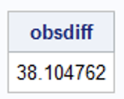
Permutation Test of the Mean: SAS
data pvaluecalc;
set newds;
count = 0;
if (COL1 >= 38.1048) then count = count + 1;
pvalue = count / 10000;
run;
proc univariate data = pvaluecalc;
var pvalue;
output out = pvalue sum = pvalue;
run;
proc print data = pvalue;
run;
proc iml;
L = {45,53.1,40.8,75.5,46.7,85.4,85.6,18.2,43.2};
U = {23.6,13.3,34.2,18.1,56.1,-8.1,-20.1};
obsdiff = mean(L) - mean(U);
print obsdiff;
call randseed(12345); /* set random number seed */
alldata = L // U; /* stack data in a single vector */
N1 = nrow(L); N = N1 + nrow(U);
NRepl = 9999; /* number of permutations */
nulldist = j(NRepl,1); /* allocate vector to hold results */
x = sample(alldata, N//NRepl, "WOR"); /* create all resamples */
nulldist = x[,1:N1][,:] - x[,(N1+1):N][,:]; /* compute all mean differences */
title "Histogram of Null Distribution";
refline = "refline " + char(obsdiff) + " / axis=x lineattrs=(color=red);";
call Histogram(nulldist) other=refline;
create newds from nulldist;
append from nulldist;
run;

Slide 26
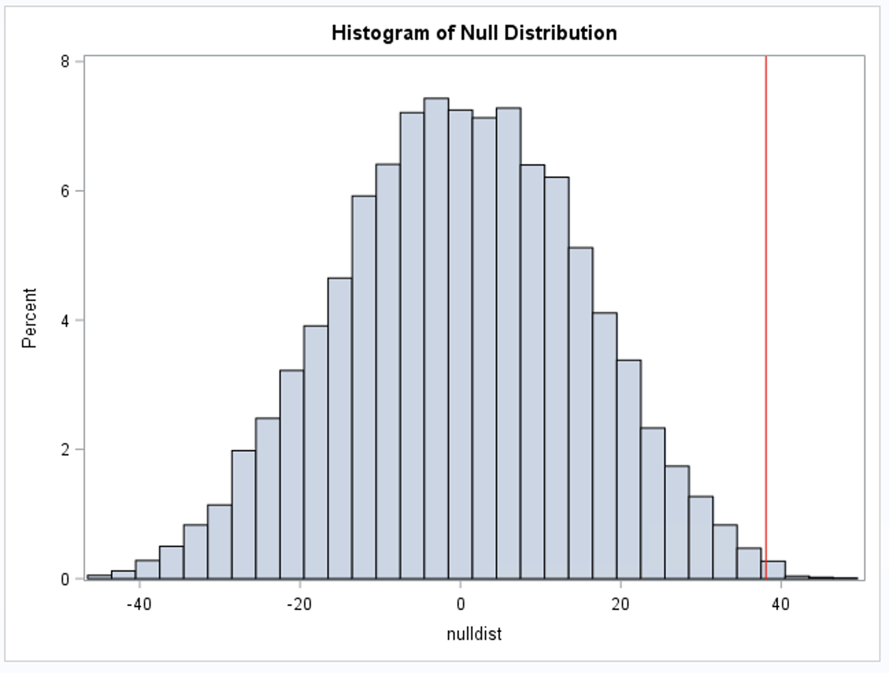
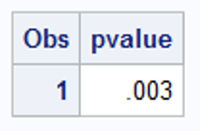
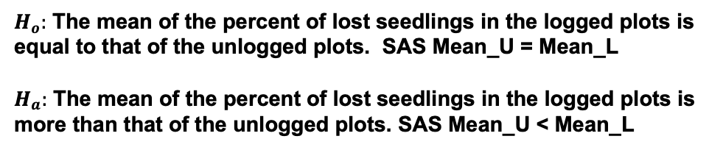
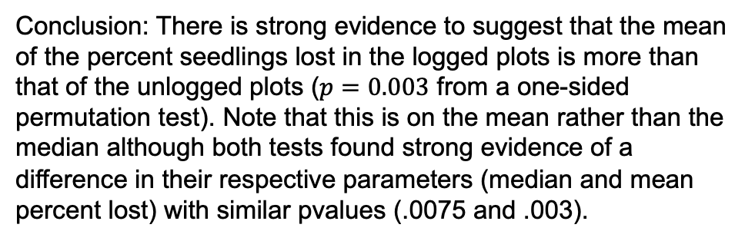
Permutation Test of the Mean: SAS
$H_{o}:$ The mean of the percent of lost seedlings in the logged plots is equal to that of the unlogged plots. SAS Mean_U = Mean_L
$H_{a}:$ The mean of the percent of lost seedlings in the logged plots is more than that of the unlogged plots. SAS Mean_U < Mean_L
Conclusion: There is strong evidence to suggest that the mean of the percent seedlings lost in the logged plots is more than that of the unlogged plots ($p=0.003$ from a one-sided permutation test). Note that this is on the mean rather than the median although both tests found strong evidence of a difference in their respective parameters (median and mean percent lost) with similar pvalues (.0075 and .003).

Slide 27
Permutation Test of the Mean: R
logging <- read.csv(file.choose(),header = TRUE); # This reads it in if you directory is set to the right folder.
number_of_permutations = 10000;
xbarholder = c();
counter = 0;
observed_diff = mean(subset(logging, Action == "L")$PercentLost)-mean(subset(logging, Action == "U")$PercentLost)
for(i in 1:number_of_permutations)
{
scramble = sample(logging$PercentLost,16);
L = scramble[1:9];
U = scramble[10:16];
diff = mean(L)-mean(U);
xbarholder[i] = diff;
if(diff >= observed_diff)
counter = counter + 1;
}
hist(xbarholder, col = "lightblue", main = "Differences Means Under Ho", xlab = "Diff of Means");
abline(v = observed_diff,col = "red", lwd = 3);
pvalue = counter / number_of_permutations;
pvalue

Slide 28


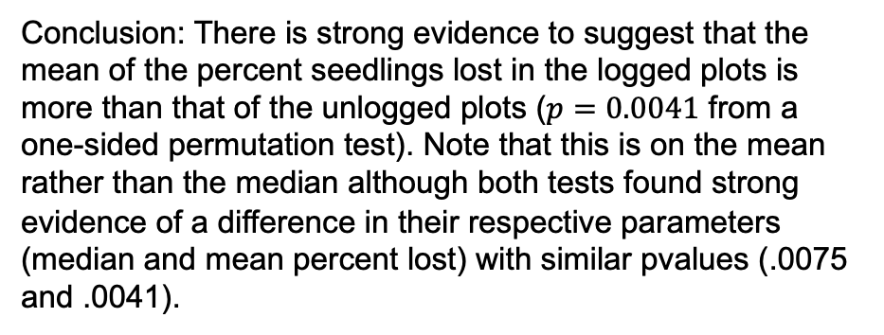
Permutation Test of the Mean: R
Conclusion: There is strong evidence to suggest that the mean of the percent seedlings lost in the logged plots is more than that of the unlogged plots ($p=0.0041$ from a one-sided permutation test). Note that this is on the mean rather than the median although both tests found strong evidence of a difference in their respective parameters (median and mean percent lost) with similar pvalues (.0075 and .0041).

Slide 29
Permutation Test of the Median: R
logging <- read.csv(file.choose(),header = TRUE); # This reads it in if you directory is set to the right folder.
number_of_permutations = 10000;
xbarholder = c();
counter = 0;
observed_diff = median(subset(logging, Action == "L")$PercentLost)-median(subset(logging, Action == "U")$PercentLost)
for(i in 1:number_of_permutations)
{
scramble = sample(logging$PercentLost,16);
L = scramble[1:9];
U = scramble[10:16];
diff = median(L)-median(U);
xbarholder[i] = diff;
if(diff >= observed_diff)
counter = counter + 1;
}
hist(xbarholder, col = "lightblue", main = "Differences Median Under Ho", xlab = "Diff of Median");
abline(v = observed_diff,col = "red", lwd = 3);
pvalue = counter / number_of_permutations;
pvalue

Slide 30
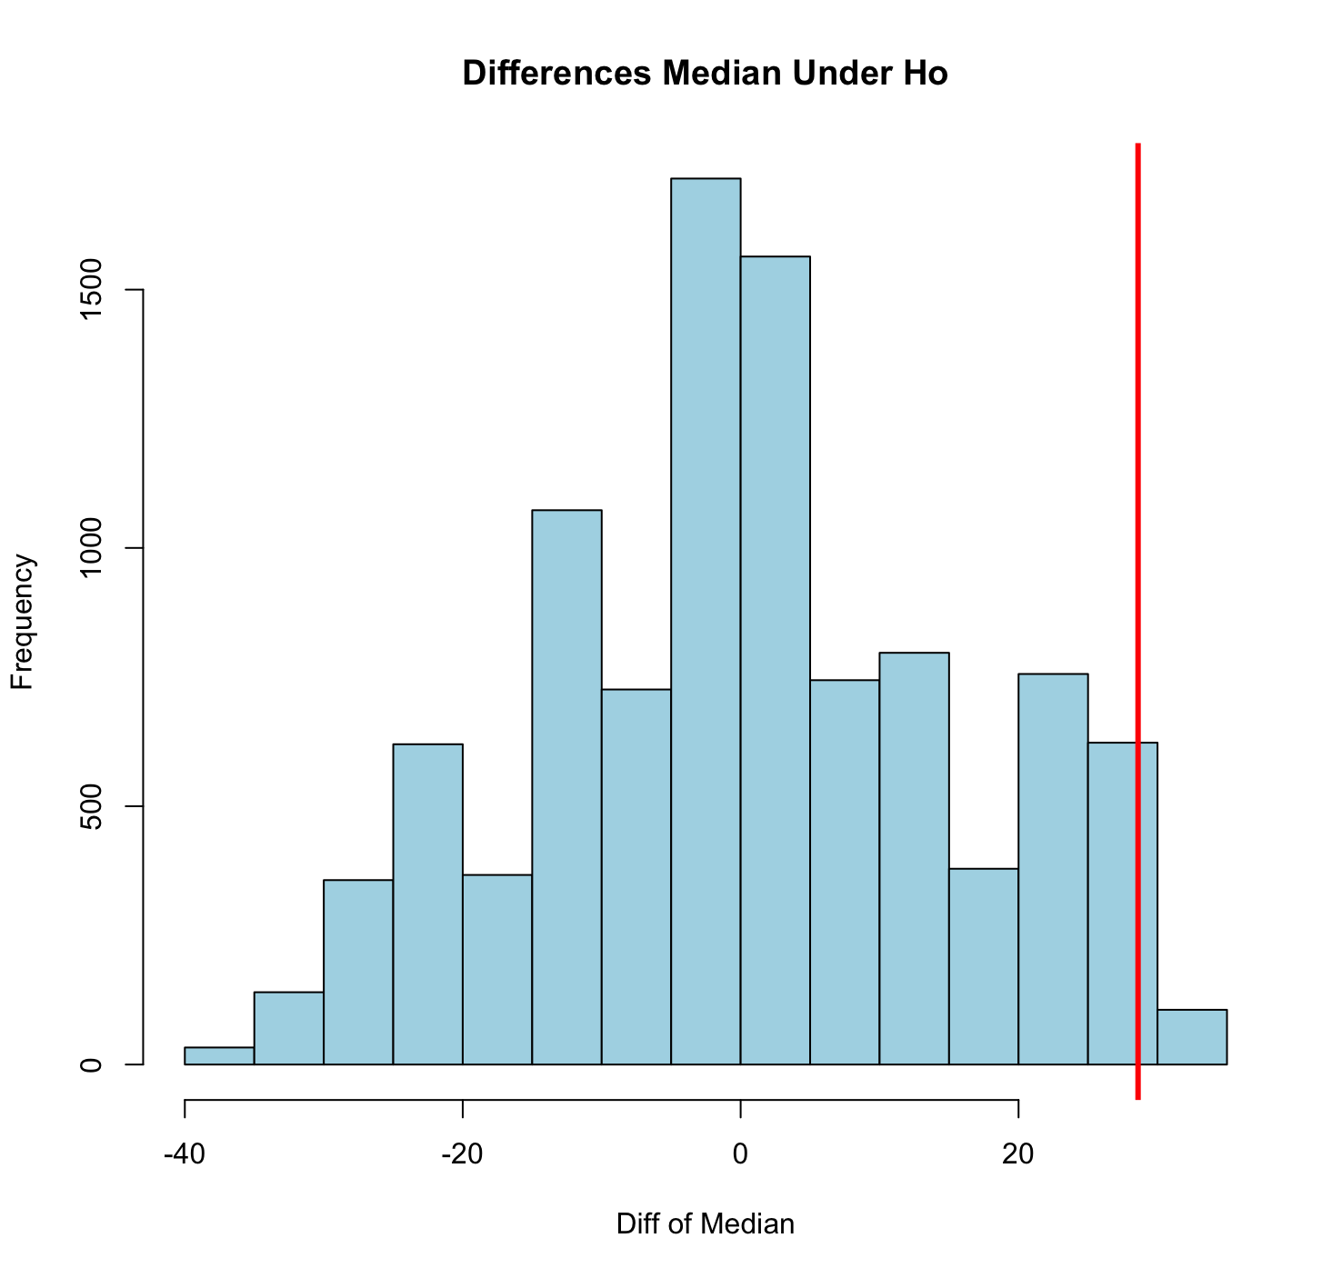

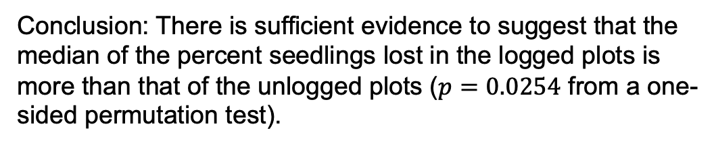
Permutation Test of the Median: R
Conclusion: There is sufficient evidence to suggest that the median of the percent seedlings lost in the logged plots is more than that of the unlogged plots ($p=0.0254$ from a one-sided permutation test).

Slide 31
End Question 2

Slide 32
Rank Sum versus Welch’s … the Take Away
If you wish to make inference on the mean and you have the sample size to invoke the CLT, Welch’s t-test is preferred by most statisticians, and it is robust to different standard deviations even when the sample sizes are not equal.
Often, especially in skewed distributions, the median is a better measure of center. For this reason, one may prefer the rank sum test even when Welch’s t-test is available.
If you have small sample sizes, you may not be very confident about the normality assumption even if the histograms and q-q plots look okay. For this reason, one may wish to be “conservative” and run the rank sum test and obtain inference on the median.
If there are outliers or censored values, the rank sum test is often the most appropriate as the t-test is not resistant to outliers and has no way of using censored data.

Slide 33

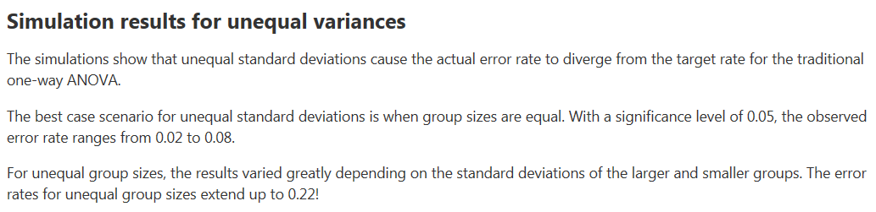
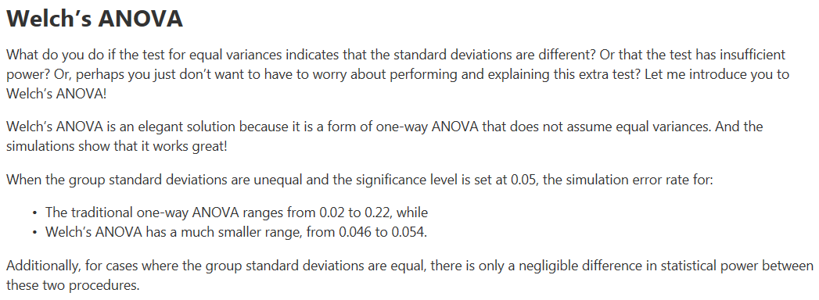
Performance of Welch’s t-test

Slide 34
Example: Medical Reasoning Test
The AMA has a diagnostic test for medical reasoning
On average, people score about 500 points on this test
We have data from 10 subjects who took the medical reasoning test. These subjects were randomly selected from St. Paul Hospital in Dallas
Not fatigued: is the baseline, taking the test before a shift
Fatigued: is after the treatment; working for 12 operational hours prior to re-taking the test.
Subject # | Not Fatigued | Fatigued
1 | 567 | 530
2 | 512 | 492
3 | 509 | 510
4 | 593 | 580
5 | 588 | 600
6 | 491 | 483
7 | 520 | 512
8 | 588 | 575
9 | 529 | 530
10 | 508 | 490
(Lower numbers = worse score)

Slide 35

Example: Keith’s Medical Reasoning Test
We can try to test whether the difference of the means between the fatigued scores and the not fatigued scores is less than zero.
$$H_{A}:μ_{fatigued}{−μ}_{not fatigued} <0$$

Slide 36

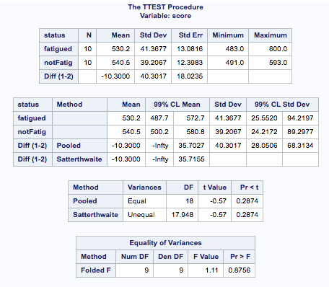
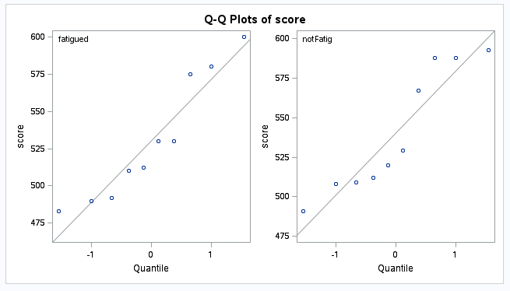
Example: Medical Reasoning Test
If we did this, we would be wrong! Why?
A fundamental assumption is violated: independence

Slide 37


Assumption Check Failure
We need to account for the dependence between the two groups

Slide 38

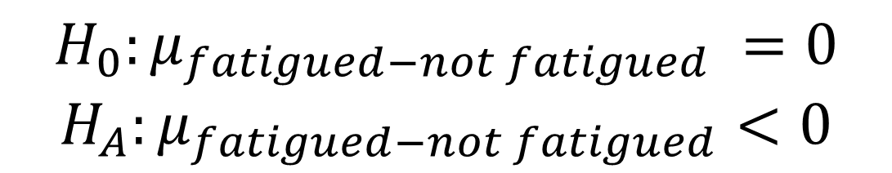
Example: Keith’s Medical Reasoning Test
Instead of testing the difference of the means:
$$H_{0}:μ_{fatigued}{−μ}_{not fatigued}=0$$
$$H_{A}:μ_{fatigued}{−μ}_{not fatigued} <0$$
Subject | Fatigued | Not Fatigued | Difference
1 | 530 | 567 | -37
2 | 492 | 512 | -20
3 | 510 | 509 | 1
4 | 580 | 593 | -13
5 | 600 | 588 | 12
6 | 483 | 491 | -8
7 | 512 | 520 | -8
8 | 575 | 588 | -13
9 | 530 | 529 | 1
10 | 490 | 508 | -18
We should test the mean of the differences:
$$H_{0}:μ_{fatigued−not fatigued} =0$$
$$H_{A}:μ_{fatigued−not fatigued}<0$$

Slide 39

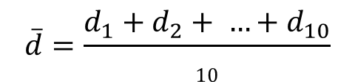
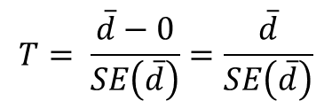
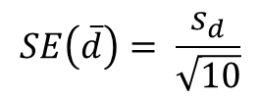
Paired t-test reduces to a one-sample t-test
H₀: d = 0
H_{a}: d < 0
(d_{i})
Subject | Fatigued | Not Fatigued | Difference
1 | 530 | 567 | -37
2 | 492 | 512 | -20
3 | 510 | 509 | 1
4 | 580 | 593 | -13
5 | 600 | 588 | 12
6 | 483 | 491 | -8
7 | 512 | 520 | -8
8 | 575 | 588 | -13
9 | 530 | 529 | 1
10 | 490 | 508 | -18
$$\overline{d}=\frac{d_{1}+d_{2}+ …+d_{10}}{10}$$
$sd$ is the sample std. dev.
$$SE\left(\overline{d}\right)= \frac{s_{d}}{\sqrt{10}}$$
$$T= \frac{\overline{d}−0}{SE\left(\overline{d}\right)}=\frac{\overline{d}}{SE\left(\overline{d}\right)}$$

Slide 40
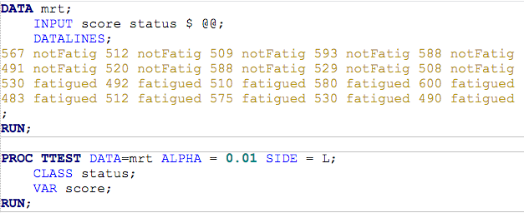
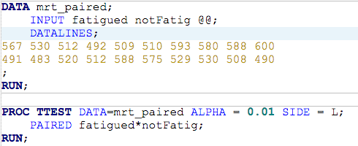
A SAS Code Comparison
Two (independent) sample T-Test
Paired T-test
R: t.test(fatigue$Fatigued, fatigue$Not_Fatigued, paired =TRUE)

Slide 41
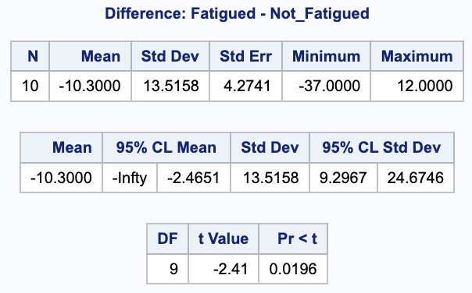
A SAS Code Comparison
Using paired data (when appropriate) instead of unpaired data allows us to tighten the confidence interval for the difference in means (yeah!) AND increase the power (the likelihood that our data properly detects a shift in score).
Paired T-test
Two (independent) sample T-Test

Slide 42
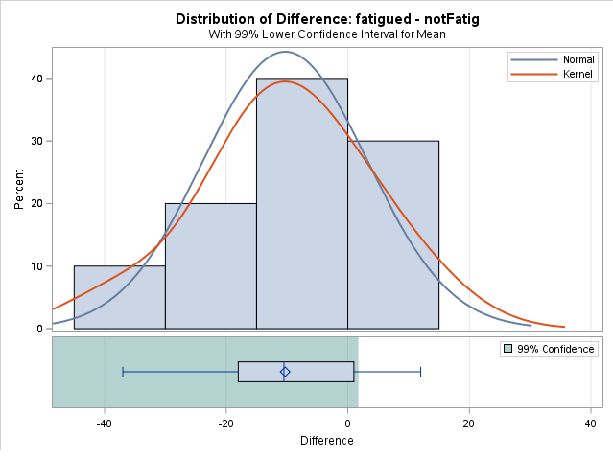
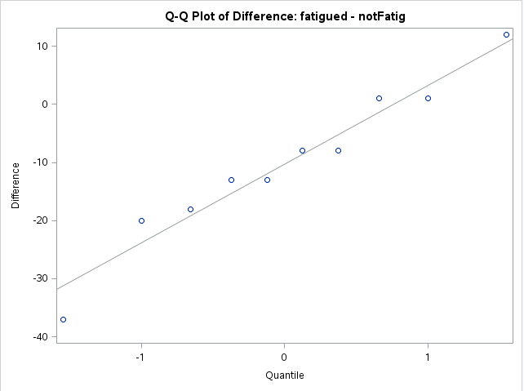
Checking the Assumptions
There is little to no evidence that the differences do not come from a normal distribution.
We will assume that the differences are independent. Is this a reasonable assumption?

Slide 43
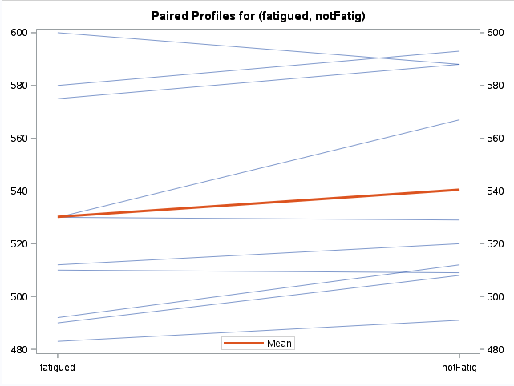
Additional Information
We can look at a profile plot
The lines connect the scores on the MRT in the “fatigued” versus “not fatigued” states
This plot is standard for SAS proc ttest with paired data.

Slide 44
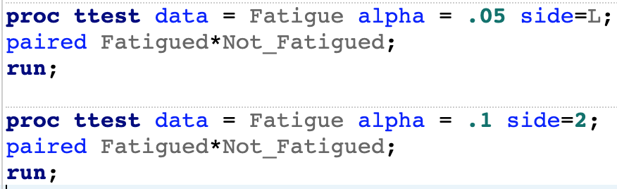

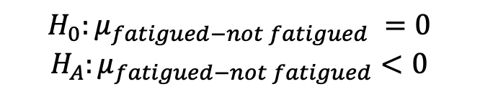
Conclusion (alpha = 0.05)
$$H_{0}:μ_{fatigued−not fatigued} =0$$
$$H_{A}:μ_{fatigued−not fatigued}<0$$
Reject H₀
Critical Value: t_{0.01,9} = -2.821
Test Statistic: t_{stat}= -2.41
P-value = 0.0196 < 0.05
Statistical Conclusion: There is enough evidence to suggest that, on average, the fatigued subjects score lower than the non-fatigued subjects (p-value = .0196). A 99% one sided confidence interval for the mean difference in scores is (-infinity, -2.4651). A more meaningful confidence interval would be a two-sided 98% confidence interval of (-18.1349, -2.4651).
Scope of Inference: Since this was a random sample from St. Paul Hospital in Dallas, we can infer that this result would be repeated for any group selected from this hospital. There is no way to guarantee a causal inference from a paired t-test.
Note: The elusiveness of the causal inference comes from the fact that the treatment that induces fatigue may itself be a confounder. Some may work for 12 hours as a surgeon and others may work 12 hours writing reports. There is reason to believe that if a difference is detected, this difference may not be due to fatigue rather may be due to the type of work.

Slide 45
Breakout!: Medical Reasoning Test
Let’s assume the client was not confident in the assumptions of the t-test given the sample size and wanted to run a non parametric test.
Perform a signed rank test to test that the median difference in medical reasoning scored (fatigued – not fatigued) is different from zero.
Subject | Fatigued | Not Fatigued | Difference
1 | 530 | 567 | -37
2 | 492 | 512 | -20
3 | 510 | 509 | 1
4 | 580 | 593 | -13
5 | 600 | 588 | 12
6 | 483 | 491 | -8
7 | 512 | 520 | -8
8 | 575 | 588 | -13
9 | 530 | 529 | 1
10 | 490 | 508 | -18

Slide 46
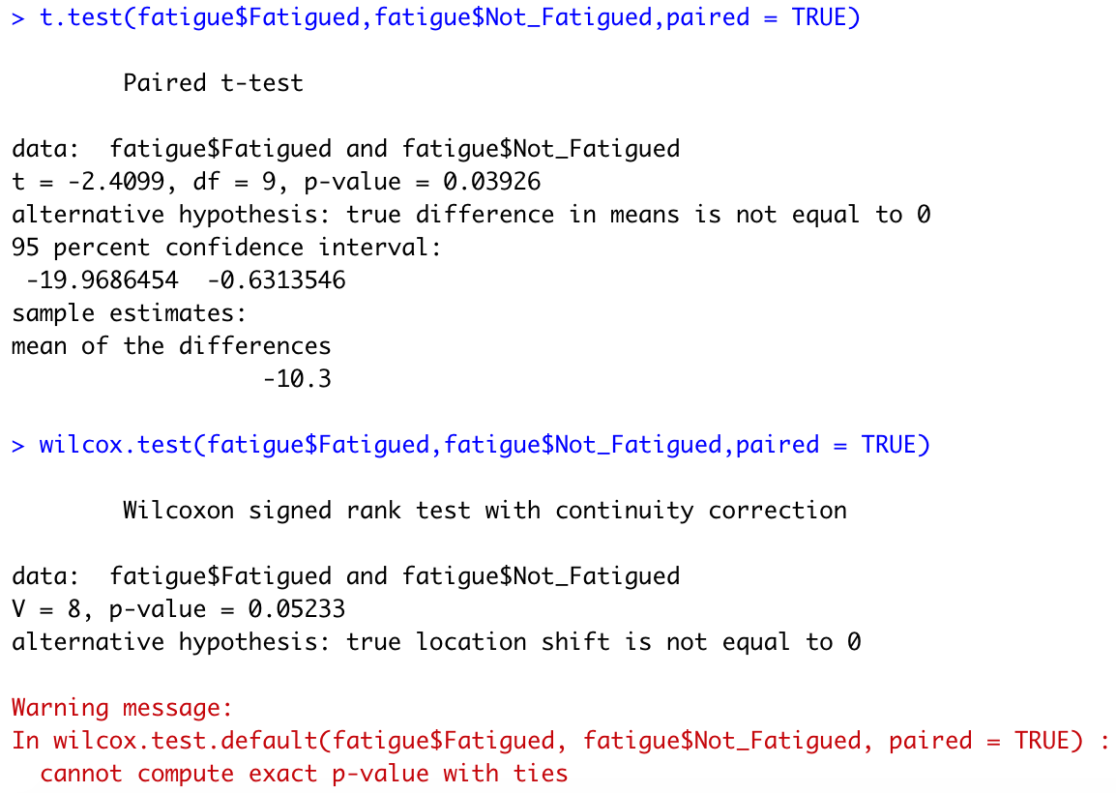
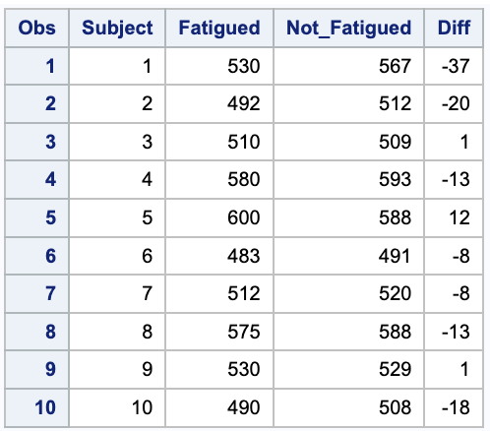
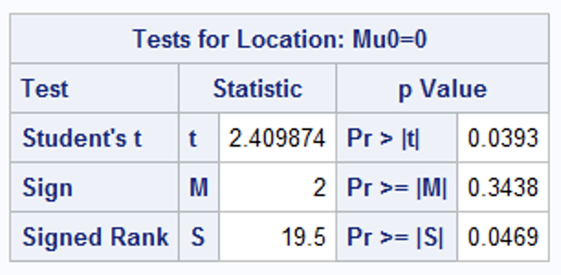
Break Out!
proc print data = Fatigue;
run;
data Fatigue;
set Fatigue;
Diff = Not_Fatigued - Fatigued;
run;
proc print data = Fatigue;
run;
proc univariate data = Fatigue;
var Diff;
run;

Slide 47
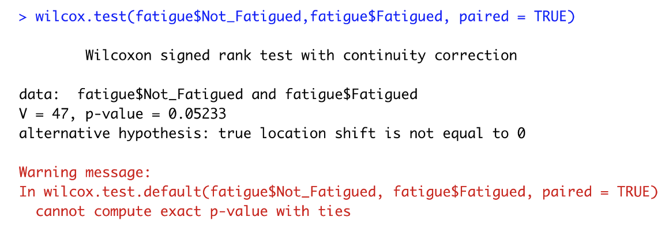
Break Out!
There is sufficient evidence to suggest that the median difference of medical reasoning scores is greater than 0. That is, there is sufficient evidence to suggest that fatigue is associated with a decrease in the medical reasoning score (pvalue = .0469 from a Signed Rank Test using SAS.). However, using the t approximation with R, the signed rank test pvalue was .05233 which would not provide enough evidence of a difference. Both pvalues are very close to the significance level of .05 thus it is suggested that the study be repeated with a possibly larger sample size.

Slide 48

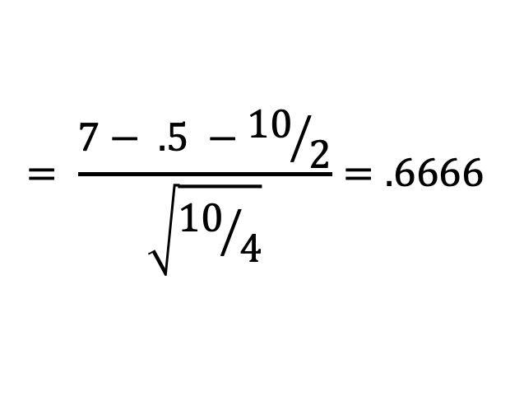

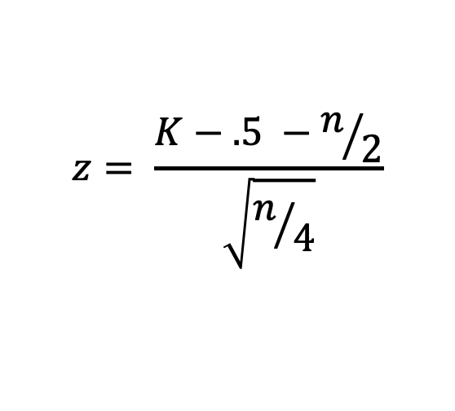
Breakout: Medical Reasoning Test: Sign Test
Subject | Fatigued | Not Fatigued | Difference | Sign
1 | 530 | 567 | -37 | -
2 | 492 | 512 | -20 | -
3 | 510 | 509 | 1 | +
4 | 580 | 593 | -13 | -
5 | 600 | 588 | 12 | +
6 | 483 | 491 | -8 | -
7 | 512 | 520 | -8 | -
8 | 575 | 588 | -13 | -
9 | 530 | 529 | 1 | +
10 | 490 | 508 | -18 | -
$$z= \frac{K−.5 −n/2}{\sqrt{n/4}}$$
$$= \frac{7− .5 −{10}/2}{\sqrt{{10}/4}}=.6666$$
$$= \frac{1.5}{\sqrt{2.5}}=.9487$$
(Lower numbers = worse score)
$$P\left(Z>.9487\right)=0.1714$$
(one sided, CC p-value)

Slide 49
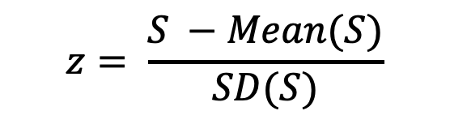

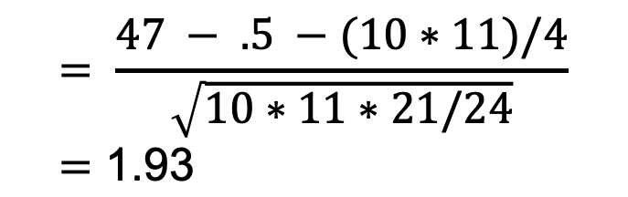
Breakout: Medical Reasoning Test: Signed Rank Test
Subject | Fatigued | Not Fatigued | Difference | Sign | Rank
1 | 530 | 567 | -37 | - | 10
2 | 492 | 512 | -20 | - | 9
3 | 510 | 509 | 1 | + | 1.5
4 | 580 | 593 | -13 | - | 6.5
5 | 600 | 588 | 12 | + | 5
6 | 483 | 491 | -8 | - | 3.5
7 | 512 | 520 | -8 | - | 3.5
8 | 575 | 588 | -13 | - | 6.5
9 | 530 | 529 | 1 | + | 1.5
10 | 490 | 508 | -18 | - | 8
$$z= \frac{S −Mean(S)}{SD(S)}$$
$$= \frac{47 − .5 −(10∗11)/4}{\sqrt{10∗11∗21/24}}=\text{1.}\text{93}$$
$$P\left(Z>1.93\right)= .0264$$
(one sided, CC p-value)
(Lower numbers = worse score)

Slide 50


Breakout: Medical Reasoning Test: Signed Rank Test
Subject | Fatigued | Not Fatigued | Difference | Sign | Rank
3 | 510 | 509 | 1 | + | 1.5
9 | 530 | 529 | 1 | + | 1.5
6 | 483 | 491 | -8 | - | 3.5
7 | 512 | 520 | -8 | - | 3.5
5 | 600 | 588 | 12 | + | 5
4 | 580 | 593 | -13 | - | 6.5
8 | 575 | 588 | -13 | - | 6.5
10 | 490 | 508 | -18 | - | 8
2 | 492 | 512 | -20 | - | 9
1 | 530 | 567 | -37 | - | 10
$$z= \frac{S −Mean(S)}{SD(S)}$$
$$= \frac{47 − .5 −(10∗11)/4}{\sqrt{10∗11∗21/24}}=\text{1.}\text{93}$$
$$P\left(Z>1.937\right)= .0264$$
(one sided, CC p-value)
(Lower numbers = worse score)

Slide 51


Example of Signed Rank Test in Practice
https://online.ucpress.edu/cse/article/5/1/1536396/118929/Using-Case-Studies-to-Improve-the-Critical

Slide 52

Break Out!
https://documentation.sas.com/?cdcId=pgmsascdc&cdcVersion=9.4_3.5&docsetId=procstat&docsetTarget=procstat_univariate_details17.htm&locale=en

Slide 53
Question 3: Takeaways!
Please provide at least 4 takeaways from this section and any questions that you may have. These questions will help design the live session for this unit.
This question will be the last question of every For Live Session Assignment. The idea is that this deck will serve as a document that you can reference in the future to remember what was covered in this section. For instance, this may come in handy for the Capstone and will hopefully become useful in your career. Most immediately, it may become handy as a quick reference for your Midterm and Final! Some students find it very useful and spend a few slides summarizing the asynch material while others learn different ways and only had the minimum 4 takeaways. Either is fine and will earn you full credit for this question.

Slide 54
Question 4: Questions!
Please provide any question or topics of discussion that came up in this Unit! These will help help us optimize our live session for maximum learning and takeaways!
This question will be the last question of every For Live Session Assignment. The idea is that this deck will serve as a document that you can reference in the future to remember what was covered in this section. For instance, this may come in handy for the Capstone and will hopefully become useful in your career. Most immediately, it may become handy as a quick reference for your Midterm and Final! Some students find it very useful and spend a few slides summarizing the asynch material while others learn different ways and only had the minimum 4 takeaways. Either is fine and will earn you full credit for this question.

Slide 55
Resources
https://stat-methods.com/home/wilcoxon-signed-rank-sas/
https://documentation.sas.com/?cdcId=pgmsascdc&cdcVersion=9.4_3.5&docsetId=procstat&docsetTarget=procstat_univariate_details17.htm&locale=en

Slide 56
End For Live Session Assignment Unit 5!

